Slide 1
Overview
Informix Requirement
Installation Options
`Installation Owner
GUI Mode Installation
CUI Mode Installation
Silent Mode Installation

Slide 2
Where To Get Informix
Download Developer Edition (Free)
www-01.ibm.com/software/data/informix/downloads.html
Passport advantage for Purchase Edition
https://www.ibm.com/software/passportadvantage/pao_customer.html

Slide 3
Installation Requirement
System requirements
https://www.ibm.com/support/pages/informix-server-system-requirements
Disk Space
Approximately 750 MB of disk space is required for a typical installation.
Some installation require more disk space. The installation application informs you of the total disk space that is required by your setup before you copy the binary files to your host computer.
RAM
Approximately 1 GB RAM is required.
Temporary disk space
Ensure that you have 2 GB free space available in your temporary directory (/tmp)
You can change the location of the temporary directory by setting the IATEMPDIR environment variable
JRE Requirement
Java is required (7 is recommended) However, check the machine notes for your operating system platform

Slide 4
Installation options
Typical installation
Recommended. You install the database server with all associated components, IBM® Informix Client Software Development Kit, and the IBM Informix JDBC Driver.
Custom installation
You can choose which client products to install. You can minimize the size of the database server on disk by excluding unneeded features and products.
Legacy installation
You have the same options as a custom installation, plus the product files are extracted to create a script-based non-interactive installation.
RPM installation
You have the same options as a custom installation, plus an RPM image is generated to create an RPM non-interactive installation.

Slide 5
Installation owner
Root-based installations
The standard way to install the database server is as a superuser with administrative privileges. The installation application creates the user Informix. User Informix is a user account with main authority over the database server instance.
Non-administrative(non-root) installation
If you run the installation application as a non-administrative user, that user is the non-root owner of the installation and has database server administrator (DBSA) privileges over the database server.
If you install the database server without root privileges, you cannot use the following features and tools:
Enterprise Replication for servers that have different owners
High-availability clusters
Auditing through role separation
The ON-Bar utility for backing up and restoring data
The onperf utility to monitor database server performance

Slide 6

User and group Informix
Check
Check whether user & group Informix present or not. If user present, then leave this step else create Informix group and user as root user.
Create
Create group informix
groupadd informix
Create
Create user Informix and add user to the informix group
useradd -c "IBM IDS" -g informix informix

Slide 7
Directory to install Informix
Set up a directory for Informix installation
– Owned by Informix
Recommended:
/opt/IBM/informix_<version>
e.g.: /opt/IBM/informix_12.40FC10 (full version #)
Set running directory
ln -s /opt/IBM/informix_12.40FC10 /opt/IBM/informix
Important: The database server will not start unless the installation directory is secure.

Slide 8
Preparing for installation
Prepare
Before you install Informix database server products, you must prepare your system and plan for choices that you must make during the installation process.
Obtain
Obtain the software.
Review
Review the Informix components that can be installed with the database server. You can install all of them or some of them.
Ensure
Ensure that your computer meets the system requirements.
Choose
Choose a user account with which to install the product. ( non-root owner and an owner with root owner).
Choose
Choose an installation directory.
Decide
Decide between a typical or custom installation
Decide
Decide whether to create initialize database instance server during installation
Decide
Decide which edition that you might want to install.

Slide 9
Installation types
GUI mode installation
– Most common on Windows and Mac
– Standard installation prompts
Console mode installation
– Most commonly used on UNIX/Linux systems
– Number based options
Silent installation.
- Can use in both GUI and CUI

Slide 10
Run The Installer
Place downloaded file in a directory
– This is just for the installation
Extract the installer .tar.gz or zip file
Tar –xvf ids12.10.tar
/ids_install

Slide 11
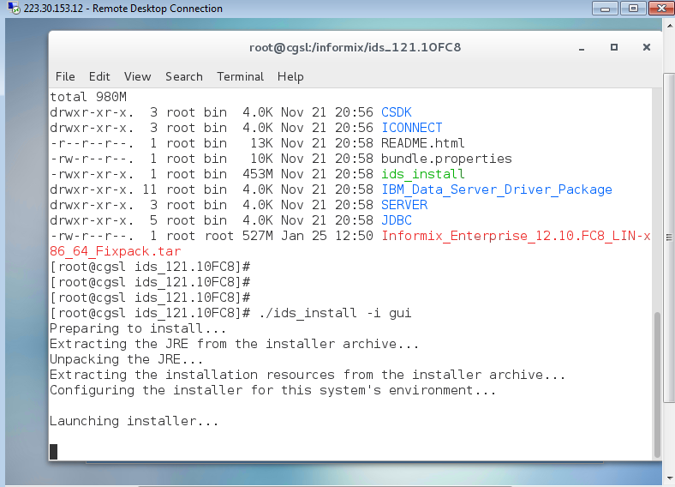

Slide 12
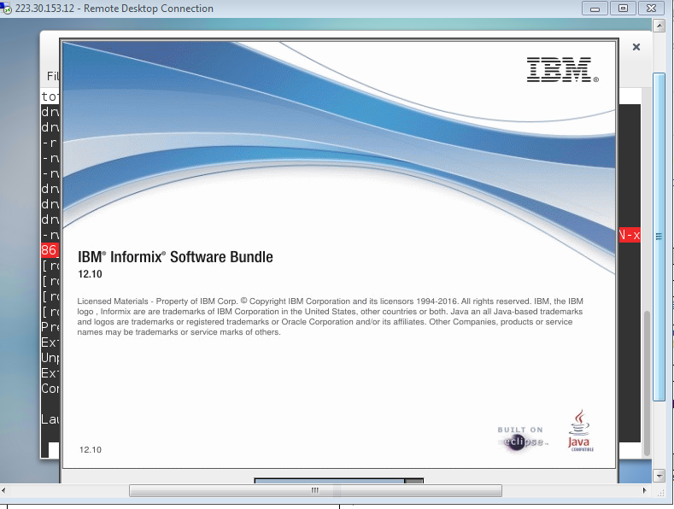
GUI Mode

Slide 13
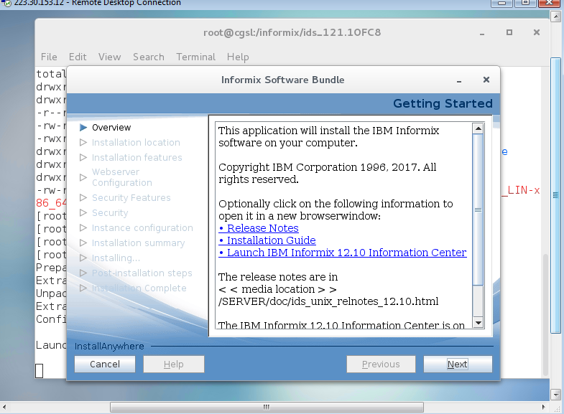

Slide 14
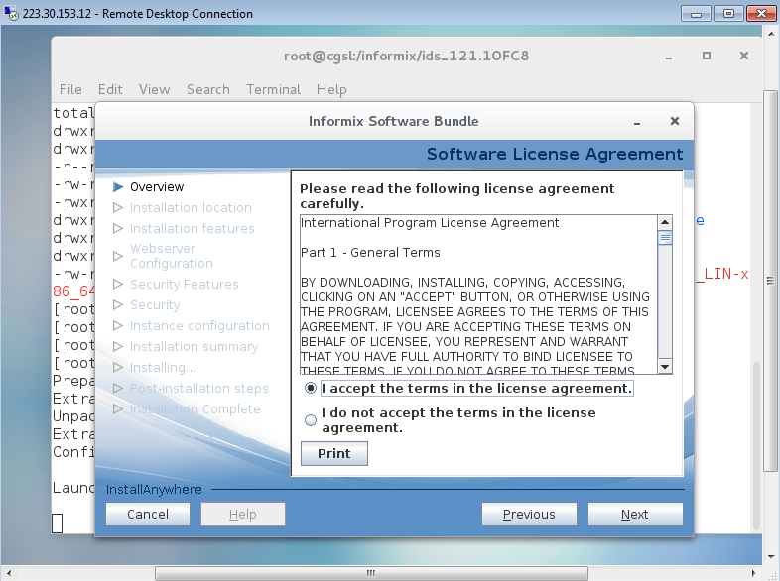

Slide 15
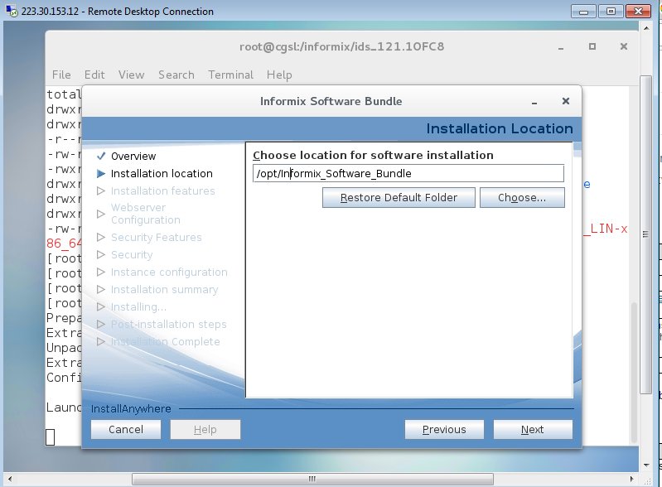

Slide 16
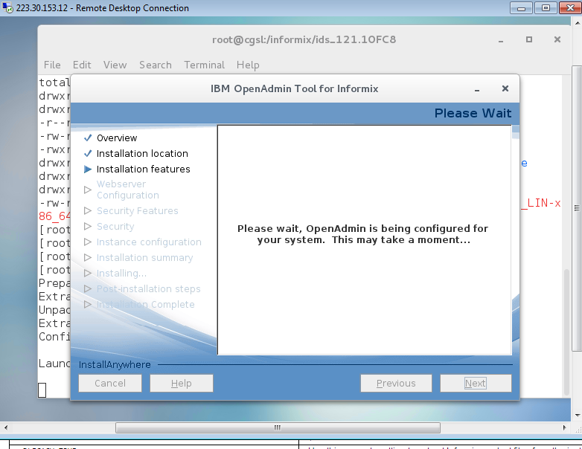

Slide 17
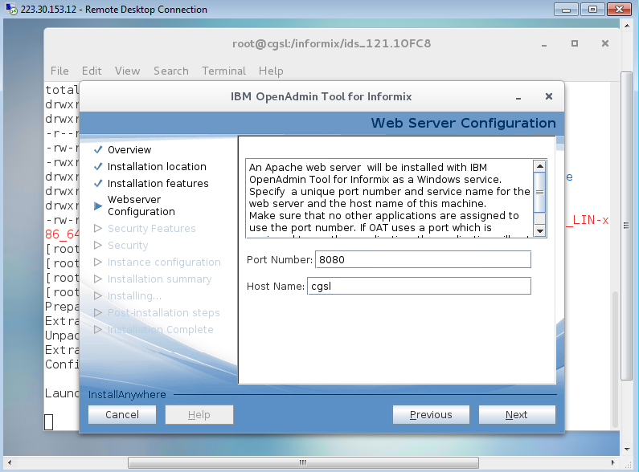

Slide 18
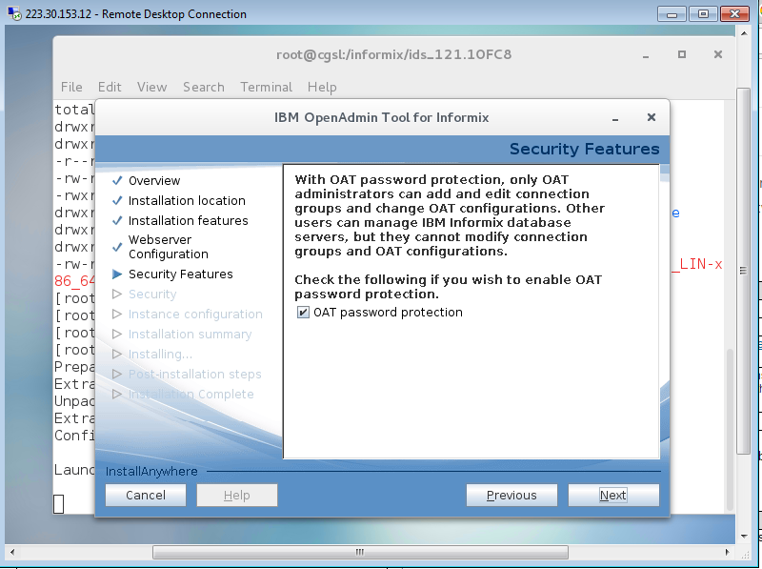

Slide 19
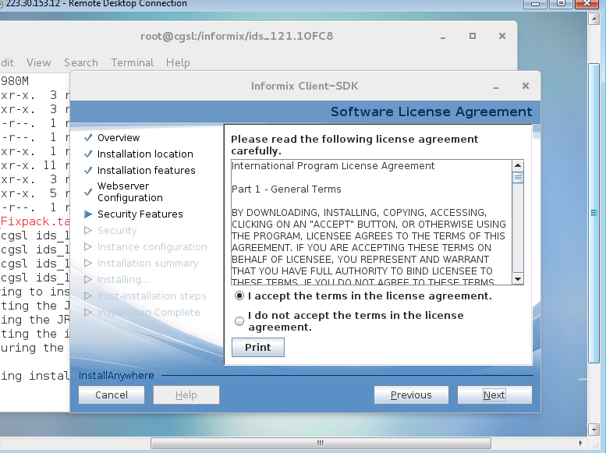

Slide 20
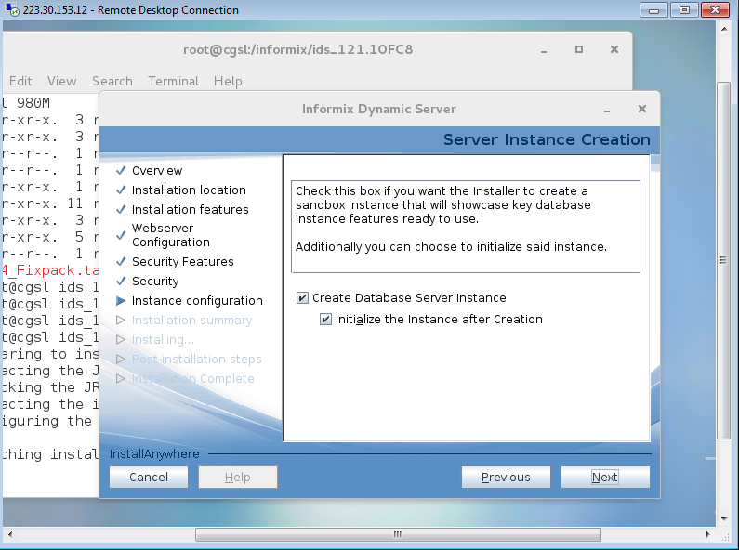

Slide 21
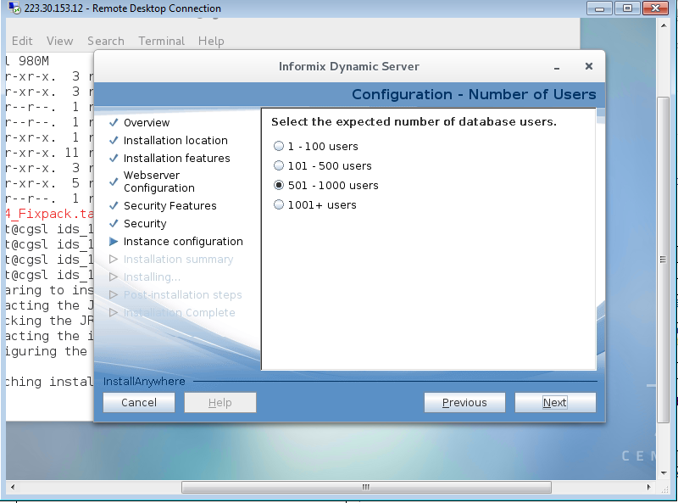

Slide 22
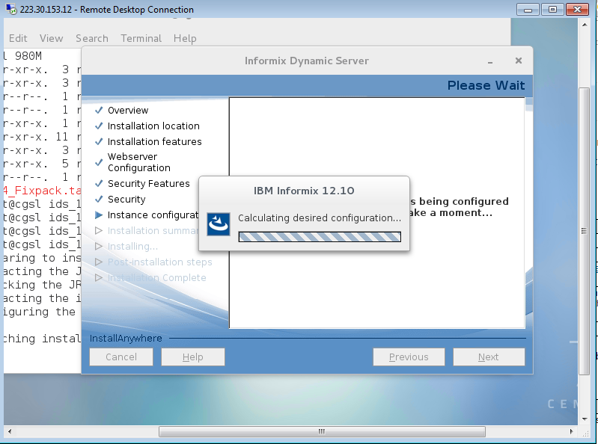

Slide 23
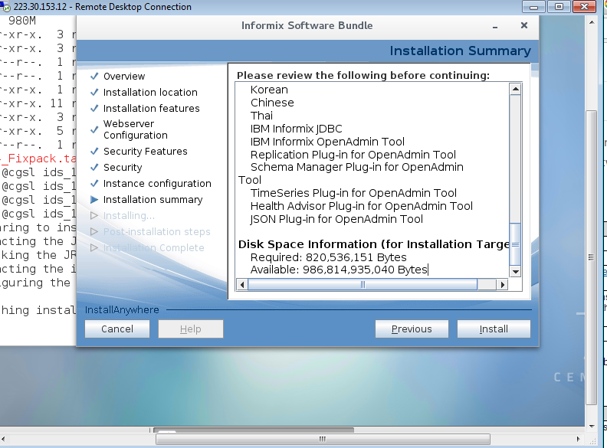

Slide 24
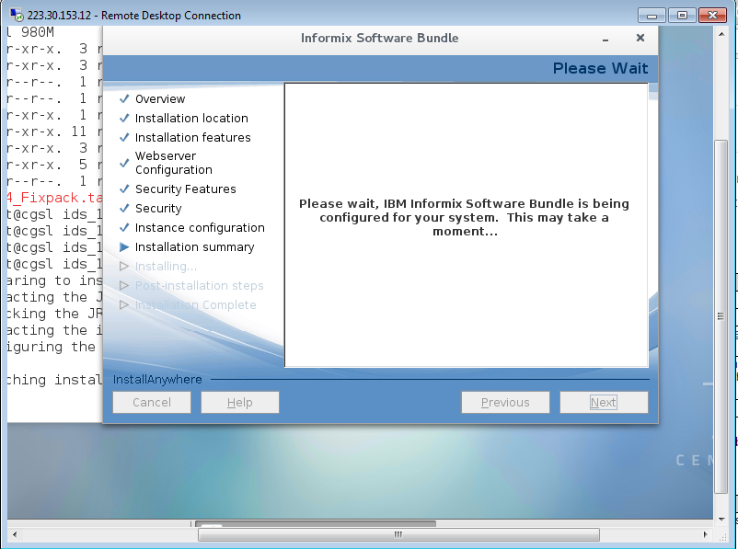

Slide 25
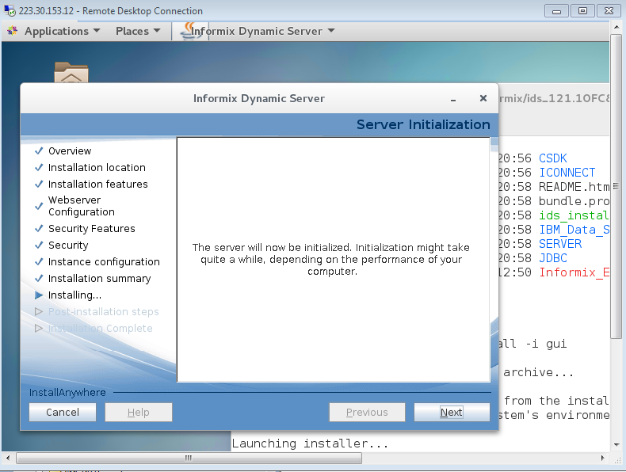

Slide 26
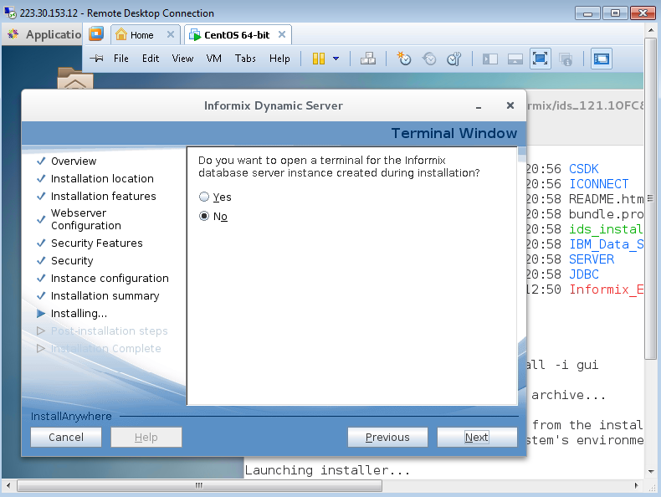

Slide 27
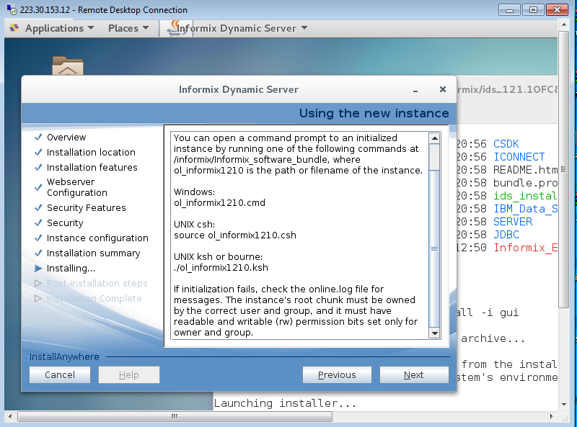

Slide 28
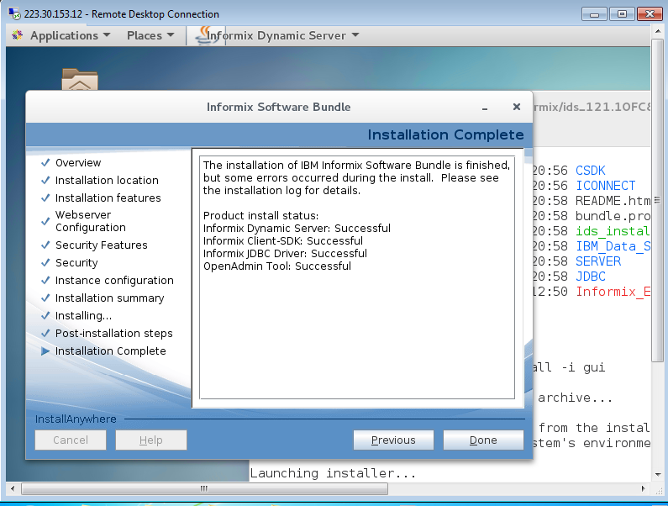

Slide 29
Silent mode
Establish a response file by doing one of the following
Start a product installation application in GUI or console mode and specify the -r option to generate a response file.
Save a local copy of the bundle.properties file that is on the installation media, rename the file, and configure the settings for the silent installation
Copy the response file to the computer where you want to install Informix or one of the bundled client programs.
Run the silent installation command
ids_install -i silent -f path_name
Note: You need to verify the informix dir path, it should be secure.

